Slide 1
Product Sales Analysis
Made by Mamdouh Dabjan

Slide 2
The main goal behind this project is to compare different marketing methods and evaluate their effectiveness.
This evaluation will take into considering both revenue and effort/time required

Slide 3
Methodology
Important note about data cleaning methodology:
Excluded rows where the revenue amount was missing
The steps taken to analyze the data:
Computed descriptive statistics (Median)
Visualized the data
Used the Kruskal-Wallis method to ensure that there is a statistically significant difference between the groups

Slide 4
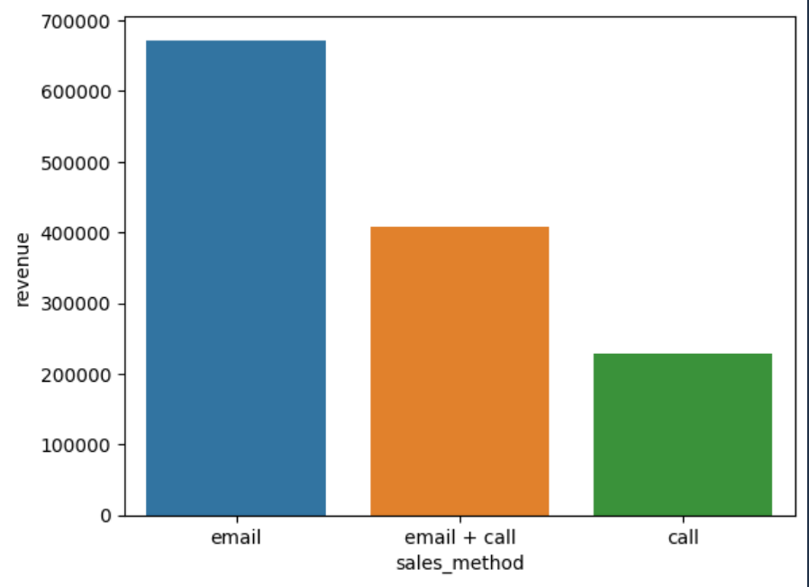
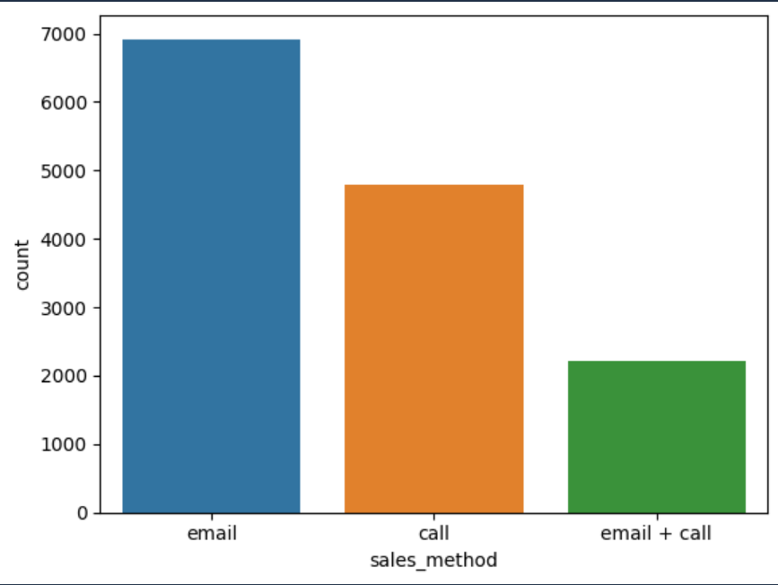
The number of customers and total revenue per method

Slide 5
In hindsight, it looks like the email method is the best one since it is used with most of the customers and it produces the most revenue
However, further analysis
demonstrates otherwise.

Slide 6
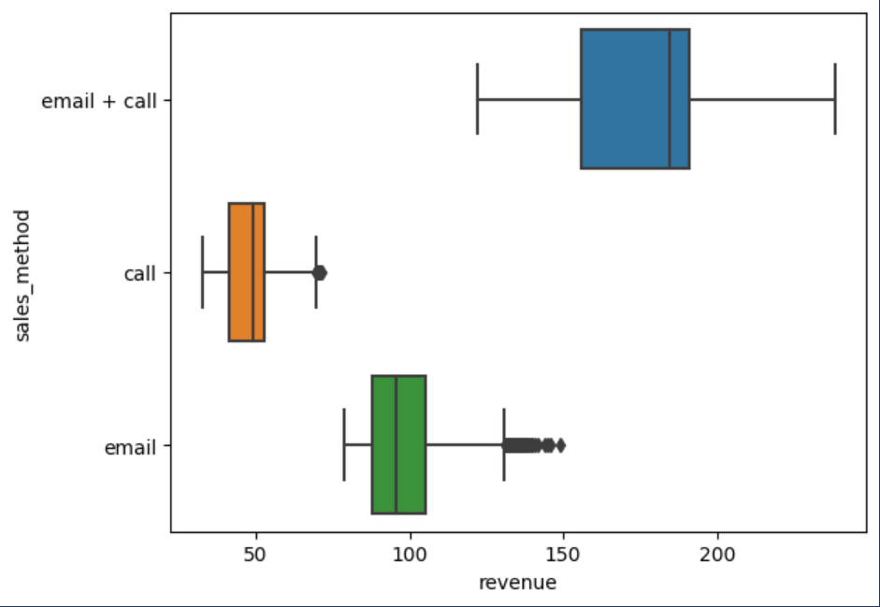
The revenue across methods

Slide 7
The previous slide clearly demonstrates that the email and call method tends to, on average, produce more revenue

Slide 8
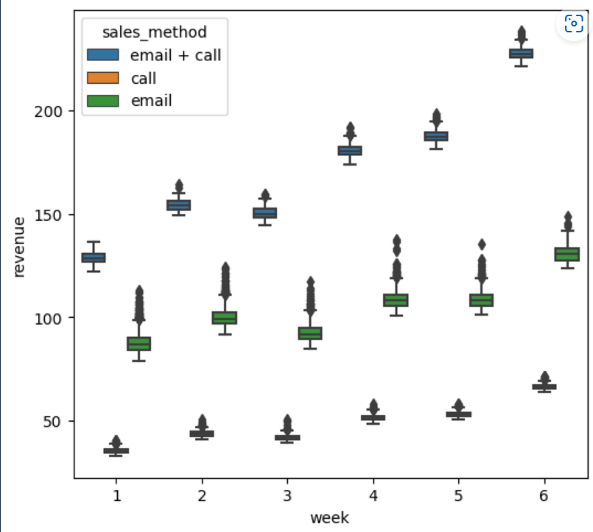
When we account for how many weeks after the product was launched the purchase was, we find it is positively correlated with revenue

Slide 9
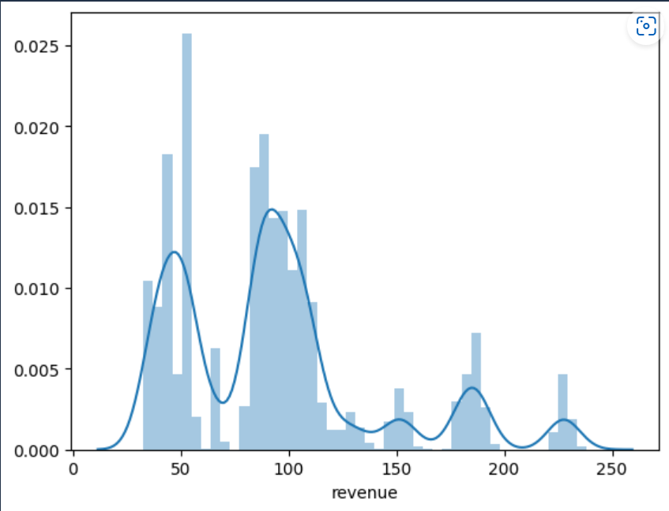
The overall distribution of revenue

Slide 10
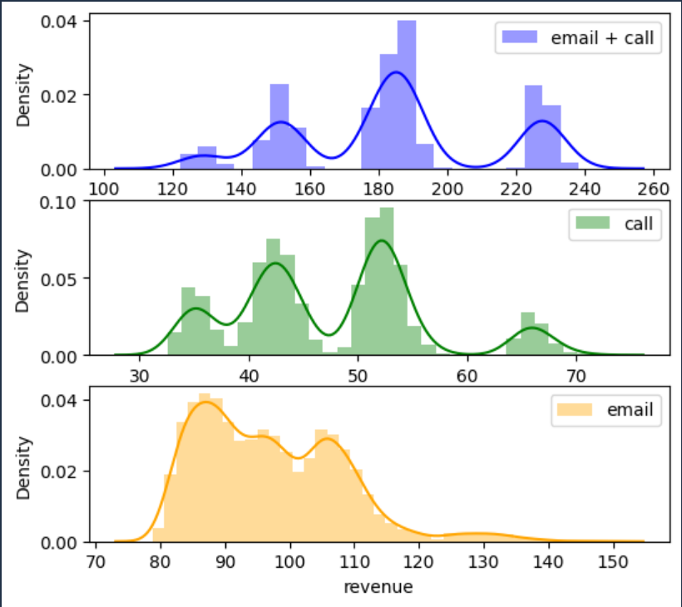
The distribution of revenue for each method

Slide 11
Based on the previous analysis, I recommend that the company should focus on transitioning from the call method to the email and call method. This change could potentially generate more revenue from the 5000 customers who are currently being contacted via the call method.

